Slide 1
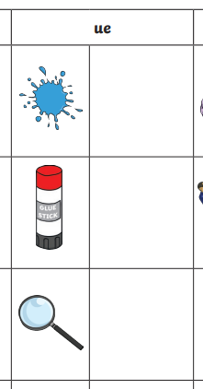
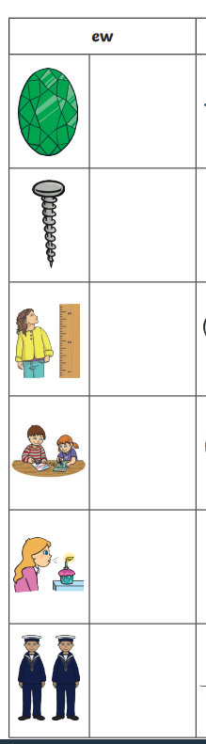
Can you give me a c______?
The colour is…
Write the correct spelling for the picture.
Choose the correct sound – either ew or ue
Look at the picture she d____
She g______
5 cm last year!
Y2 Spelling Homework 3.7.26

Slide 2
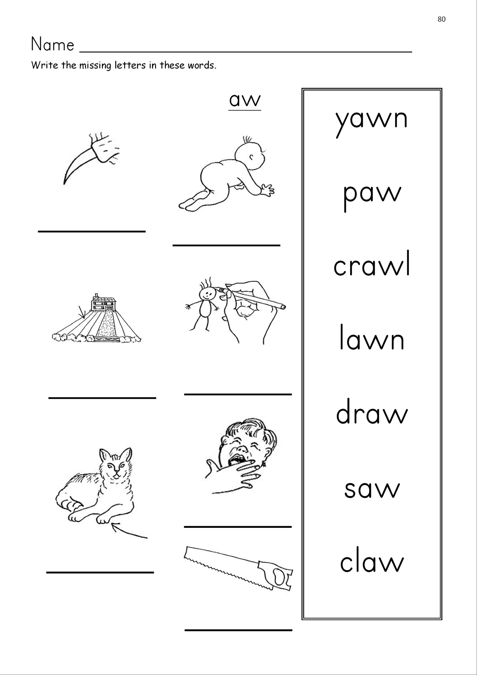
Answers!

