Slide 1

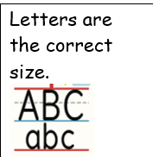
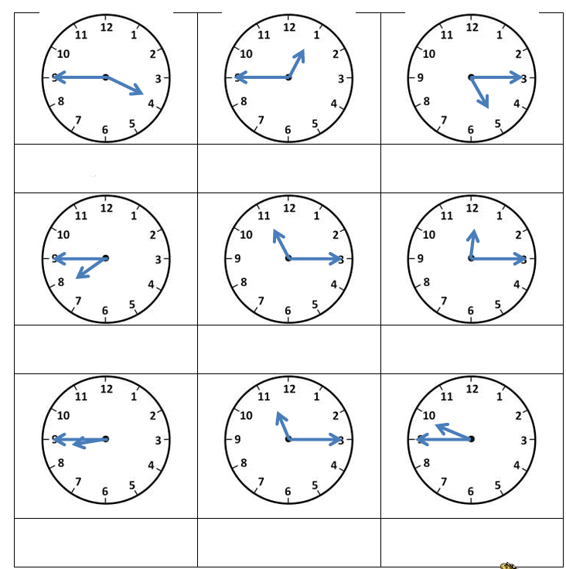
Year 2 Maths Homework – VERY CONFIDENT
3.7.26
Help words: past minutes

Slide 2
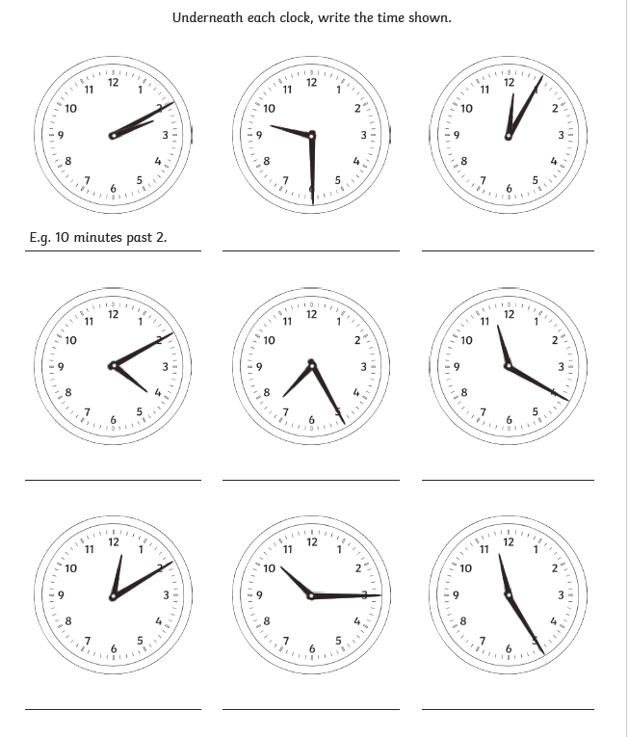
Year 2 Maths Homework – VERY CONFIDENT
3.7.26
Help words: past minutes
One
Two
Three
Four
Five
Six
Seven
Eight
Nine
Ten
Eleven
Twelve

