Slide 1

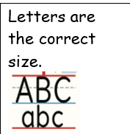
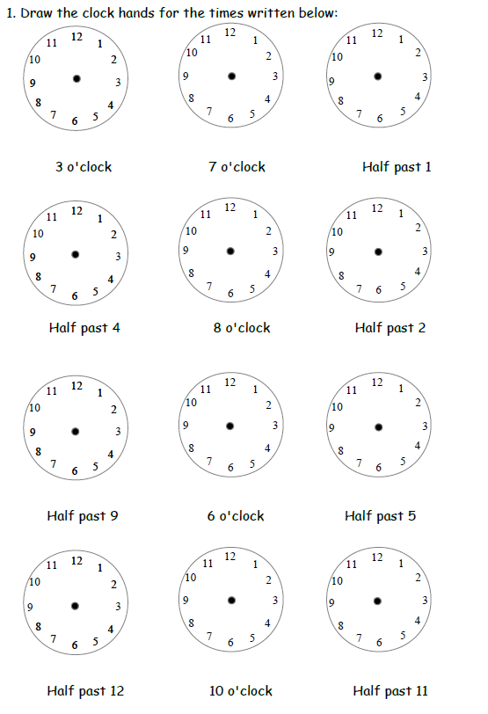
Year 2 Maths Homework
3.7.26
Help words: o’clock half past

