Slide 1

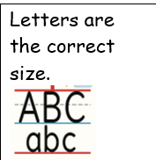
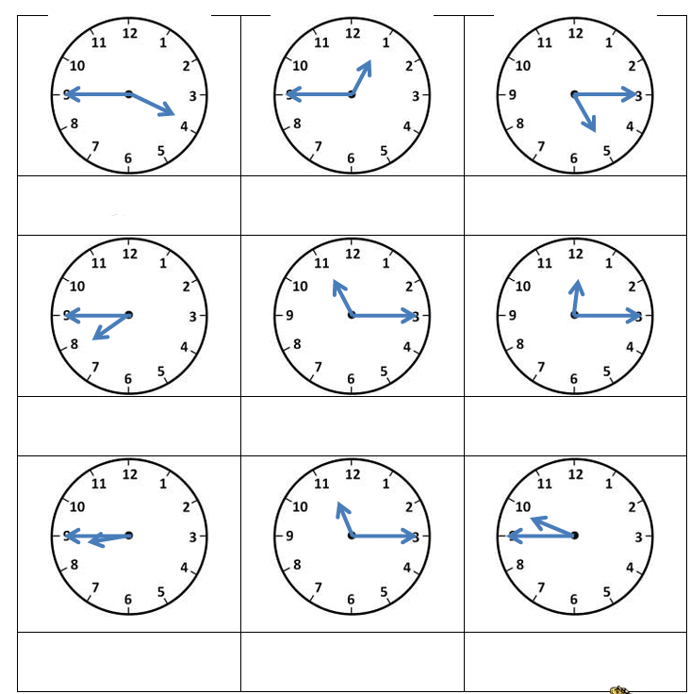
Year 2 Maths Homework – CONFIDENT
3.7.26
Help words: quarter to quarter past

