Slide 1
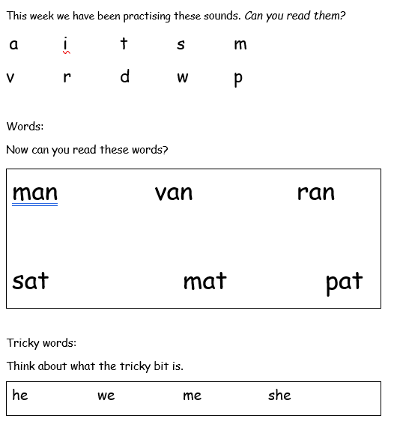

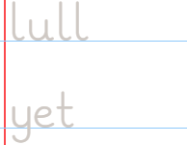
Y1 Homework 2.10.26
Now trace and copy these letters and words.
Think about the size of the letters and sitting them on the line.

Slide 2
