Slide 1
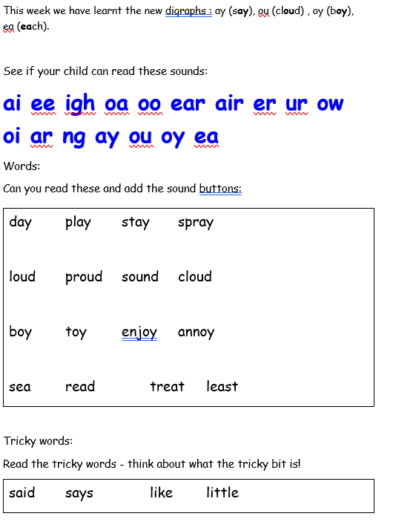
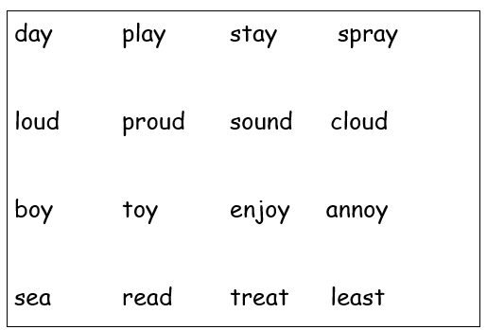

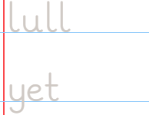
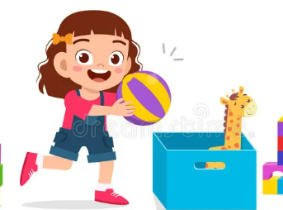
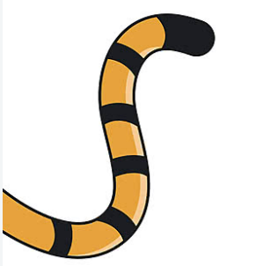
Y1 Homework 2.10.26
Think about the size of the letters and sitting them on the line.
Practise writing these words with the ay / ai diagraph. TIP: ‘ay’ goes on the end of a word and ‘ai’ sits in the middle.
Word:
Word:
Parent hint: we like to pl_ _ with the ball. :
Parent hint: this is a tiger’s t_____

Slide 2
